Slide 1
A Novel Approach to Identifying and Predicting Cancer Vulnerabilities
Stuart Lab
Andrew E. Davidson
Mentor: Alana Weinstein
March 2020

Slide 2
Big Idea: Finding and Predict Vulnerabilities
Use gene dependency data to find similar gene vulnerabilities
May lead to new therapeutic options
Predict gene dependency from gene expression data
Clinical setting it’s possible to get gene expression data
Not easy to get gene dependency data

Slide 3
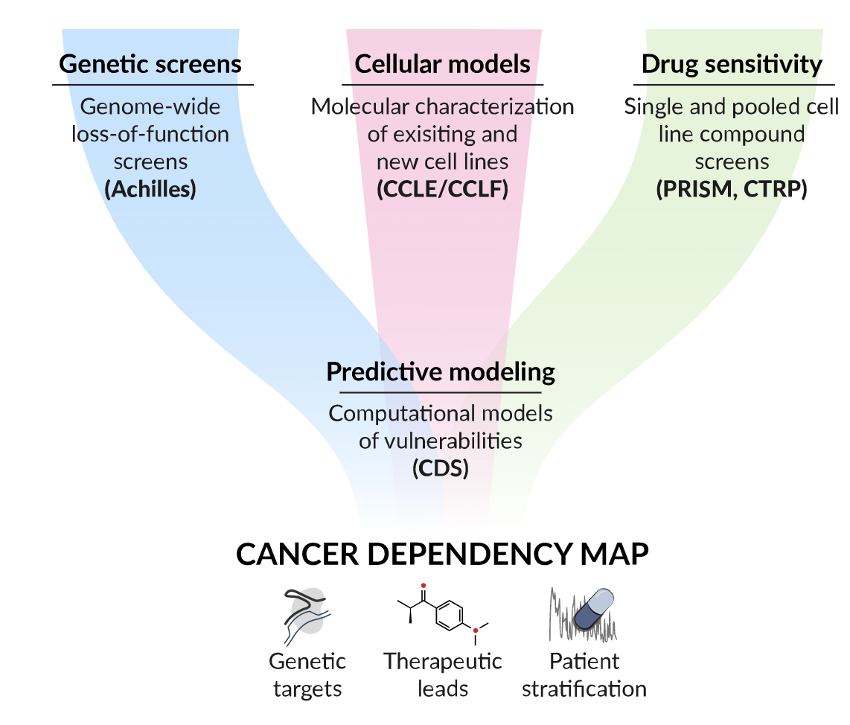
Broad Institute: Cancer Dependency Map

Slide 4
Recommender System: Hybrid Collaborative Filtering (Low Rank Matrix Factorization)
Cell Lines x 19
Genes Dependencies
Genes x 19

Slide 5
Results: 5 most similar gene pairs
RGPD3 (653489), RGPD2 (729857)
Members of the same gene family, have similar function
EGR2 (1959), WEE2-AS1 (285962)
EGR2 may promote WEE2 transcription (from gene cards)
STAT4 (6775), SLCO3A1 (28232)
TOP1MT (116447), GK (2710)
SCNN1D (6339), P4HA2 (8974)

Slide 6
Results

Slide 7
Deep Mapper Model
Gene Expression Data
Gene Dependency Data

Slide 8
Future Directions
Compare biologic significance of LRMF embedding against other dimensional reduction techniques
Build classifiers using embedding
Mine the models
Analyze variance of learned features to identify potential bio markers
Reverse engineer biologic properties the embedding has learned
Look for previous unknown associations and correlations in the lower dimensional space
Finish Deep Mapping Model

Slide 9
Acknowledgements
Alana Weinstein
Josh Stuart

Slide 10
SCRATCH PAD / Bone Yard / WIP

Slide 11
Same discussion as previous “skittles” plot

Slide 12
Methods
Recommender systems (Low Rank Matrix Factorization Model)
Graphic of math
Learn X and Theta such that X Theta.transpose = Gene Dependency data
Deep Mapping Model
Graph of neural network architecture

